Slide 1
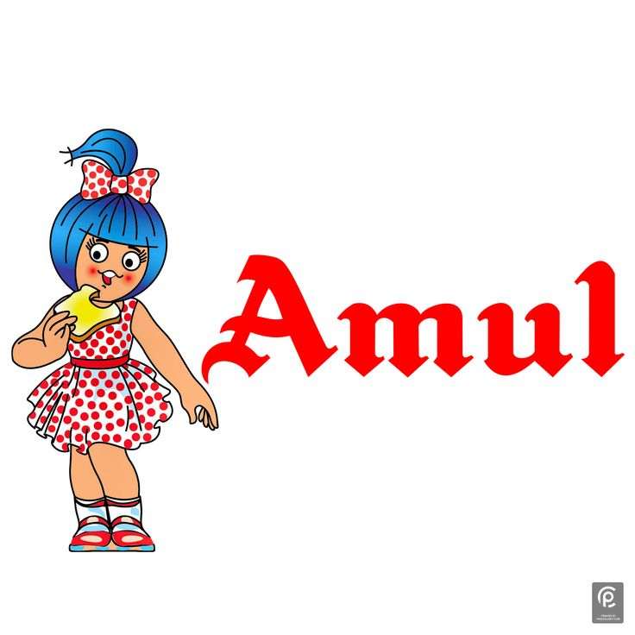
AMUL
Anand Milk Union Limited
-THE TASTE OF INDIA

Slide 2
CONTENTS
INTRODUCTION AMUL
VISION , MISSION &VALUES OF AMUL
UNIQUE SELLING POINT [USP],KPI OF AMUL
BRAND TONE OF AMUL
SMART GOALS OF AMUL
COMPETITORS OF AMUL
SWOT ANAYSIS OF AMUL
SEO&KEYWORD RESEARCH
CONTENT IDEAS & MARKETING STRATEGIES
OVERVIEW OF AMUL
INSTGRAM STORIES

Slide 3
PRESENTED BY
Team Leader : B.SOUJANYA
Team member : A.VARSHITHA
Team member : B.REDDY LIKITH
Team member :B.SANDYA SREE
Team member : D.GOVARDHAN

Slide 4
RESEARCH BRAND
AMUL
INTRODUCTION OF AMUL
Amul is an Indian dairy cooperative brand that represents a network of dairy farmers.
It is known for producing a wide range of dairy products, including milk, butter, cheese, ice cream, and more.
Amul is famous for its quality, affordability, and its innovative and memorable advertising campaigns.
1946:* Amul started as the Kaira District Cooperative Milk Producers' Union Limited in Anand, Gujarat.
1955:* It was renamed Amul, which stands for "Anand Milk Union Limited.“
The White Revolution (1960s-70s):* Under Dr. Verghese Kurien's leadership, Amul modernized dairy farming in India.It became famous for its milk, butter, and other dairy products.
Amul

Slide 5
VISION &MISSION OF AMUL
vision
Amul's vision is to provide more and more satisfaction to the farmers, employees and distributers”
MISSION
GCMMF endeavour to satisfy the taste and nutritional requirements of the customer of the world through excellence in the marketing by the committed team.
VALUES
Customer Orientation
Give Customers a good, fairdeal, Great customer relationship take time. Do not try to maximizen short term profits at the expense of the building those enduring relationships

Slide 6
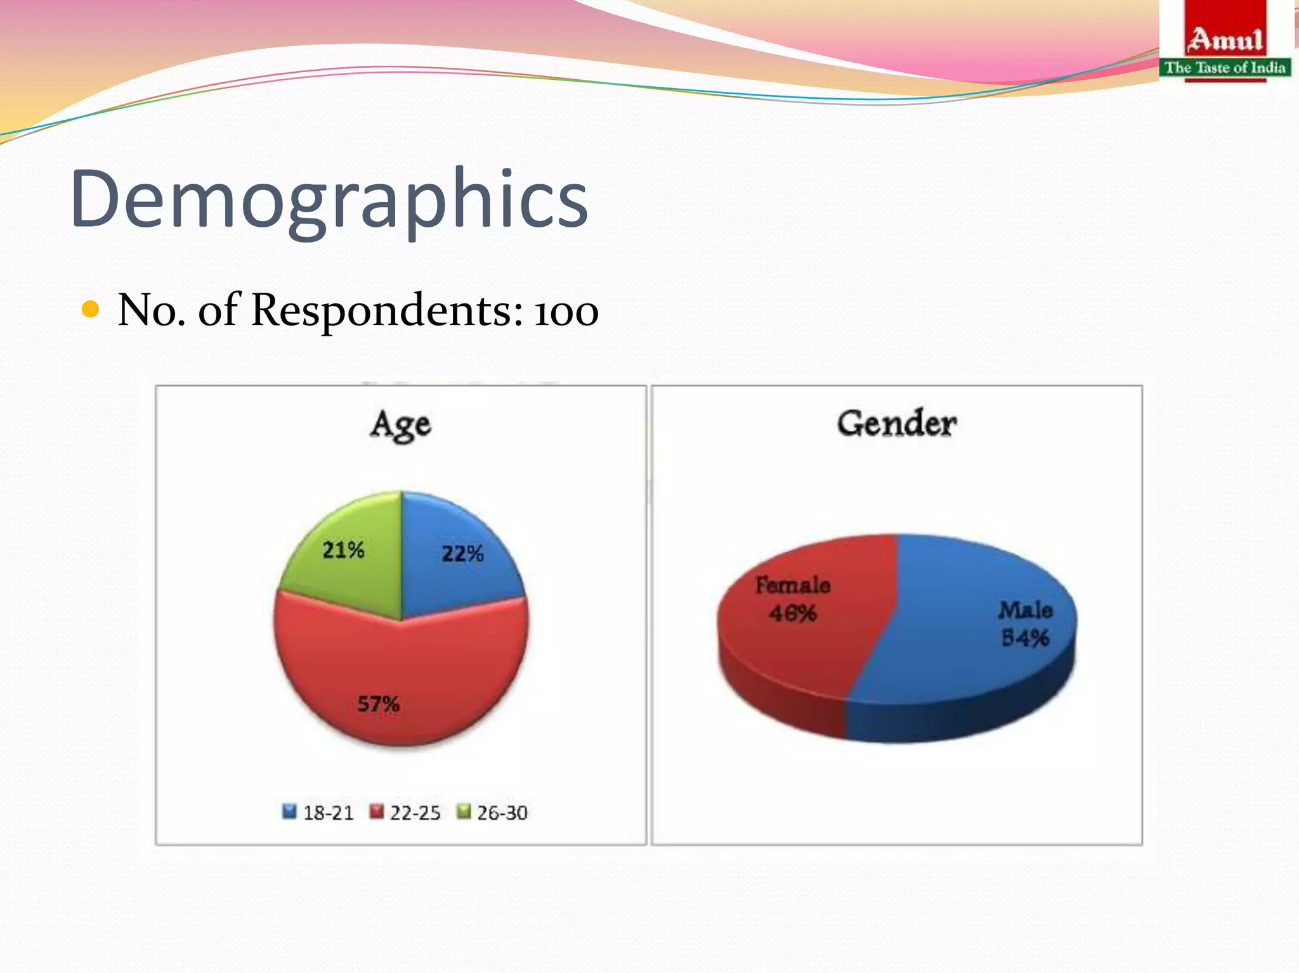
A unique selling point (USP), also called a unique selling proposition, is the essence of what makes your product or service better than competitors
UNIQUE SELLING POINT[USP]
Amul also offers the broadest range of dairy products, including ghee, butter, milk, chocolate, cheese, sweets, milk powder, ice cream, yogurt, buttermilk, and bread spreads.
The quality, and the taste of Amul's eatables, are unparalleled.
The variety of Amul's products caters to a more significant audience segment.
SHORT GOALS OF AMUL
Get more milk from farmers.
Make sure products are good quality.
Sell more in new places.
Create new dairy products.
Deliver products efficiently.

Slide 7

KEY PERFORMANCE INDICATOR OF AMUL
KPI stands for key performance indicator, a quantifiable measure of performance over time for a specific objective.
Revenue and profit.
Amount of milk procured.
Market share.
Product quality.
Distribution and availability.
Customer satisfaction.
New product success.
Environmental sustainability.
Employee happiness and productivity.
Financial health.

Slide 8
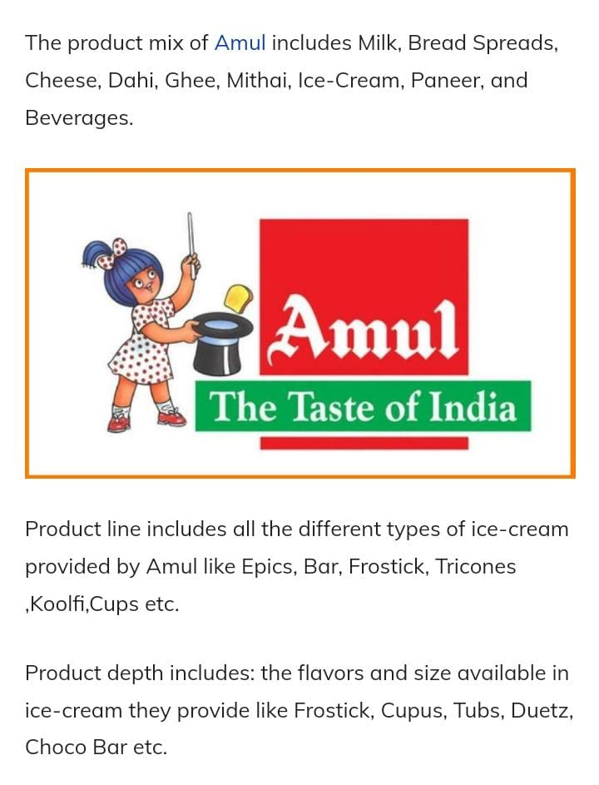
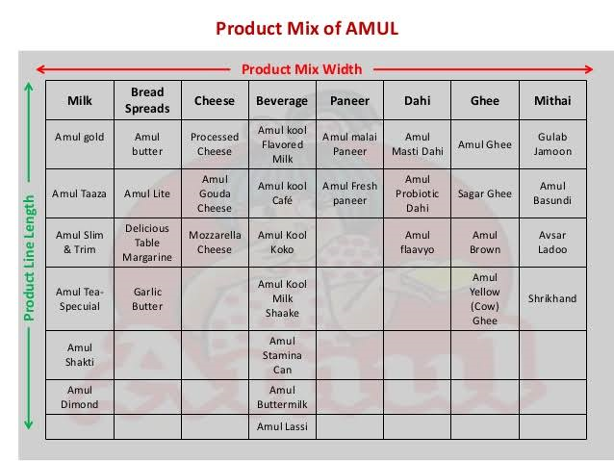
PRODUCT RANGE OF AMUL

Slide 9
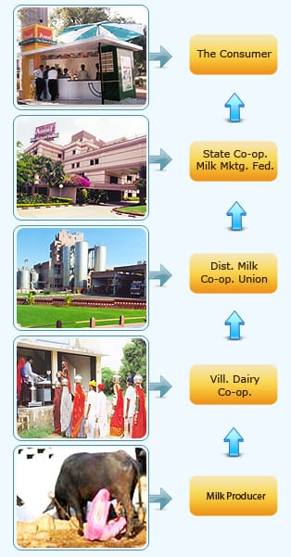

COOPERATIVE MODEL
The Amul Model of dairy development is a three-tiered structure with the dairy cooperative societies at the village level federated under a milk union at the district level and a federation of member unions at the state level.

Slide 10
COMPITETORS OF AMUL
Three competitors of Amul in the dairy and dairy product industry are:
1. Nestlé: Nestlé is a global food and beverage company that produces a wide range of dairy products, including milk, yogurt, and dairy-based beverages.
2. Mother Dairy: Mother Dairy is a prominent dairy company in India, offering a variety of dairy products, including milk, ice cream, and dairy-based foods.
3. Parag Milk Foods: Parag Milk Foods is another Indian dairy company known for its dairy products, including milk, cheese, and ghee.
These companies compete with Amul in the market by offering similar dairy products to consumers.

Slide 11
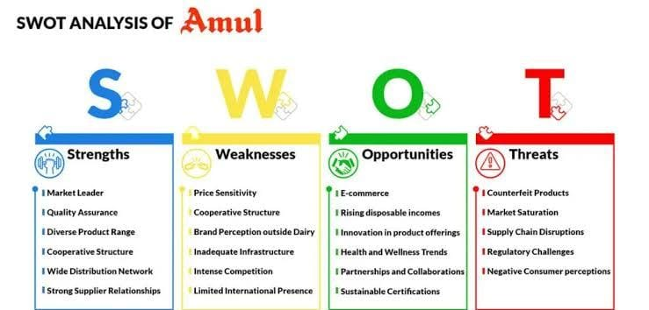
SWOT ANALYSIS
SWOT Analysis Of Amul
SWOT Analysis of Amul discusses the company’s strengths, weaknesses.
figuring out how the company is planning to expand its businesses, growth strategies which we call opportunities and threats.
As one of the largest dairy companies in India, it has several strengths, weaknesses, opportunities, and threats.

Slide 12
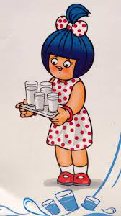
PART -2 SEO & KEYWORD RESEARCH

Slide 13
KEY RESEARCH
Research objectives for Amul:
*Find New Places to Sell*: Research where they can sell their products in new locations.
*Learn What People Like*: Understand what people prefer when it comes to dairy products.
*Make Safe and Quality Products*: Focus on maintaining safe and high-quality products.
*Efficient Production and Delivery*: Find ways to make milk processing and delivery more efficient.
*Beat the Competition*: Study competitors to be better and different.
*Create New Dairy Products*: Develop new dairy items that match trends like health and sustainability.
*Be Eco-Friendly*: Look into ways to be more environmentally friendly.
*Improve Brand Image*: Understand how people see their brand and work to make it better.
*Explore International Markets*: If they want to sell in other countries, research those markets.
*Cut Costs*: Find ways to save money while still making great products.

Slide 14
COMPETITOR KEYWORDS
Competitor keywords for Amul could include the names of other dairy and food companies that compete in similar markets, such as:
Nestlé
Mother Dairy
Parag Milk Foods
Britannia
Danone
Gujarat Cooperative Milk Marketing Federation (GCMMF)
Heritage Foods
Kwality WALL’S

Slide 15
LONG-TAIL KEYWORD
Long-tail keywords are specific keyword phrases that typically have lower search volume but can be valuable for targeting a niche audience. For Amul, a dairy and food company, long-tail keyword explorations could include:
1. "Amul milk price in [specific city/region]“
2. "Buy Amul butter online“
3. "Amul ghee benefits for health“
4. "Amul ice cream flavors 2023“
5. "Amul vs Nestlé dairy products comparison“
6. "Amul organic milk benefits“
7. "Amul dairy farm sustainability practices“
8. "Where to find Amul products near me“
9. "Amul cheese recipes for kids“
10. "Amul milk delivery subscription“
These long-tail keywords can help Amul reach a more targeted audience and provide information or products tailored to their specific needs or interests.

Slide 16
CONTENT IDEAS AND MARKETING STRATEGIES
PART -3

Slide 17
CONTENT IDEAS
Recipe Videos: Create engaging recipe videos featuring Amul dairy products, showcasing various dishes like desserts, curries, or snacks
Amul Stories: Share the inspiring stories of Amul's journey, its cooperative model, and how it has impacted farmers and consumers.
3. Dairy Tips: Offer tips on using dairy products in everyday cooking and baking, such as making the perfect paneer or ghee at home.
4. Customer Testimonials: Share positive feedback and experiences from satisfied Amul customers.
5. Health Benefits: Highlight the nutritional benefits of Amul products and how they contribute to a balanced diet.
6. Behind-the-Scenes: Show the production process, from farm to table, to give customers insight into how Amul ensures quality
7. Seasonal Specials: Promote seasonal products and recipes that can be created using Amul dairy items.

Slide 18
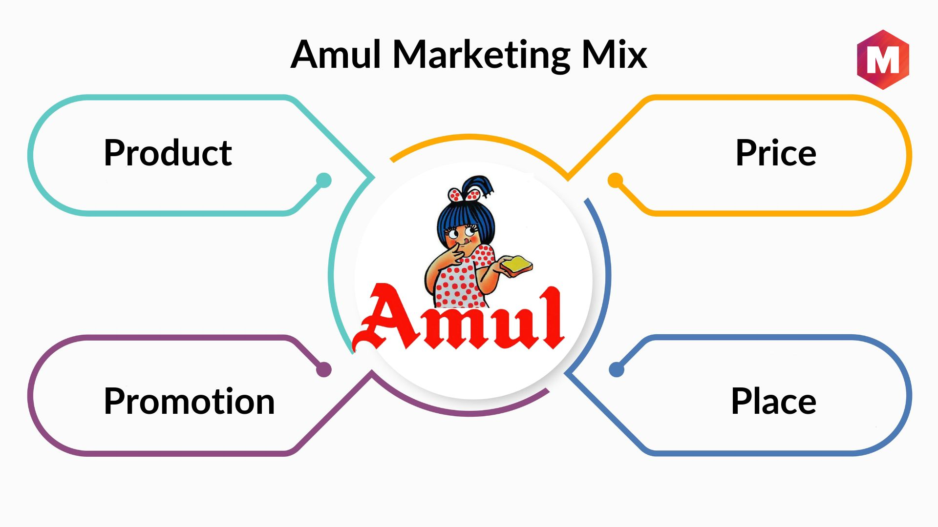
MARKETING STRAEGIES OF AMUL
Amul's Marketing And Branding Strategies & Marketing Mix.
Amul has a low-cost pricing strategy for products that are consumed regularly.
This pricing strategy of Amul made it affordable for its target audience.
Increasing the price of goods proportional to their audience's increase in income helped them retain their customer base.

Slide 19
DIGITAL STRATEGY
Amul's digital marketing strategies have effectively utilized various online platforms to engage with their audience.
Through social media channels like Facebook, Instagram, and Twitter, Amul has created a strong online presence and interacted with consumers in a personalized and engaging manner.

Slide 20
SOCIAL MEDIA ENGAGEMENT
Amul has a massive fan base of over 335K followers given that Twitter is a very different platform when compared to other social media platforms.
On various occasions, Amul posts fun graphics featuring the Amul Butter Girl.
Amul produces simple, strategic, and creative campaigns that align with its brand image and resonate with its audience.
They have dipped into social media and digital platforms to generate awareness and connect with their audience.

Slide 21
Overview Of Amul
Amul was incorporated to protect the interests of consumers and milk producers in India By Gujarat Cooperative Milk Marketing Federation Limited ( GCMMFL ).
Note: GCMMFL Stands for Gujarat Co-operative Milk Marketing Federation Ltd
Amul Stands For Anand Milk Union Limited is also known for starting the white revolution, encouraging local milk farmers to dream.
This is what made them the largest producer of milk products.
It Operates through 61 Offices, 10,000+ Dealers, and 10+ Lakh Retailers which is one of the largest networks in India after railways which has over 20+ employees.
its products range from milk, cheese, butter, milk powders, beverages, ghee, ice cream, and other milk products.
Amul has been awarded over 10+ awards for excellence in marketing and quality.

Slide 22

INSTAGARAM REEL
PART -4
https://instagram.com/stories/kiraboy16/3212604102337128888?utm_source=ig_story_item_share&igshid=MTc4MmM1YmI2Ng==
https://instagram.com/stories/kiraboy16/3212604102337128888?utm_source=ig_story_item_share&igshid=MTc4MmM1YmI2Ng==

Slide 23
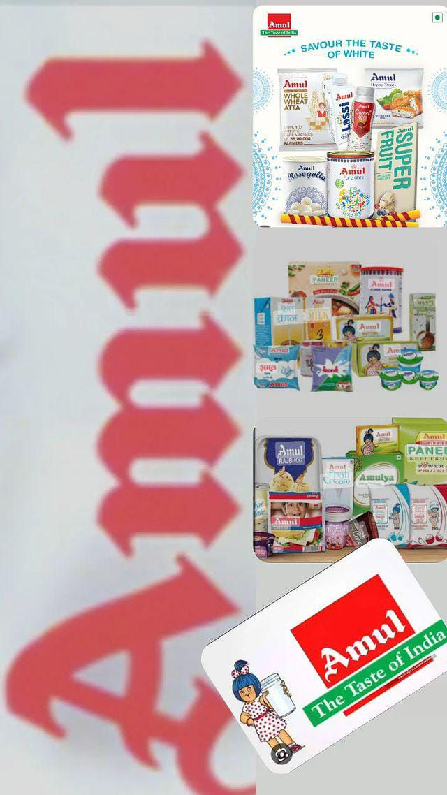
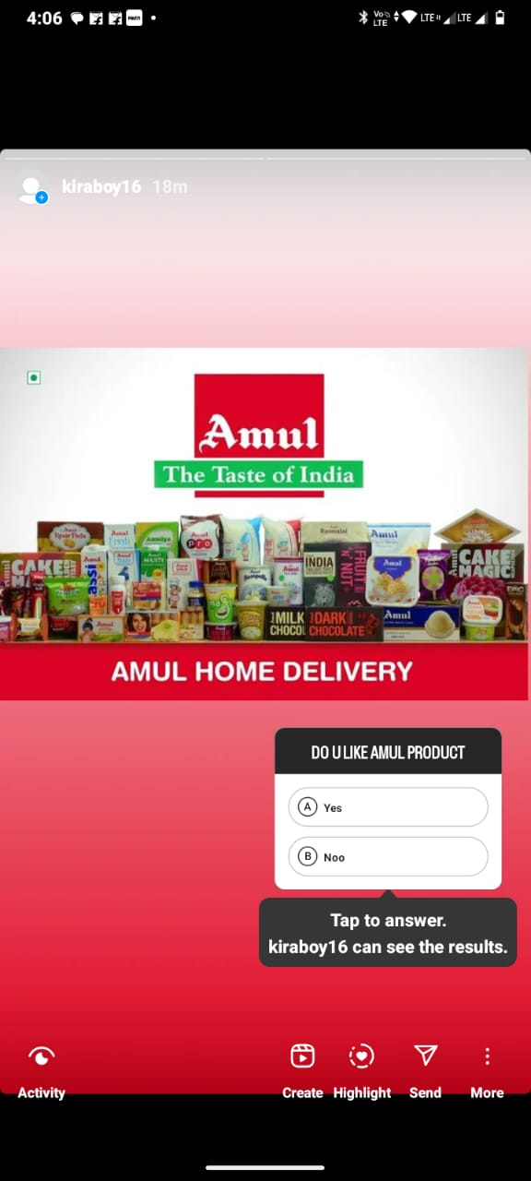


Slide 24
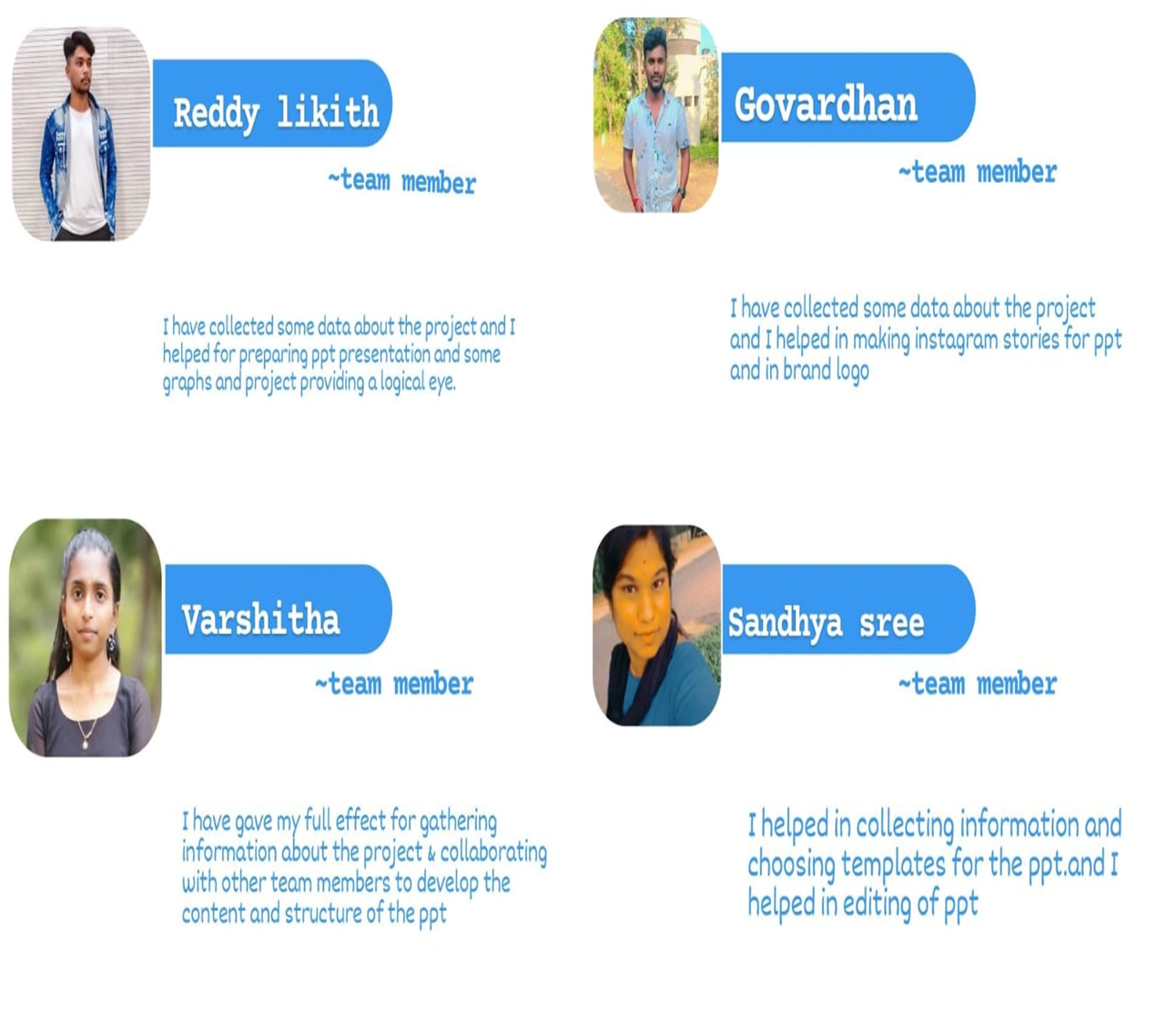

CONTRIBUTION

Slide 25

THANK YOU
BE MORE MILK

